Slide 1


TEEGALA KRISHNA REDDY ENGINEERING COLLEGE
(UGC-Autonomous)
Approved by AICTE, Affiliated to JNTUH , Accredited by NBA & NAAC ‘A’ Grade
A REAL TIME PROJECT ON
INTERNATIONAL SPACE STATION TRACKER USING PYTHON
UNDER THE GUIDANCE OF
MRS.G.PINKI
(ASSISTANT PROFESSOR)
DEPARTMENT OF CSG
PRESENTED BY
M.SAI HARSHITH (22R91A7437)
S.SAI VAMSHI (22R91A7451)
N.SAI BHANU PRASAD (23R91A7403)

Slide 2
ABSTRACT
This project involves developing a Python script to track and display the current location of the International Space Station (ISS) on a world map, along with the names of the crew members on board. The script leverages various Python modules, including urllib.requests for API interactions, json for parsing data, and webbrowser for displaying the map. It retrieves real-time latitude and longitude data of the ISS from a public API every 5 seconds and updates the map accordingly, allowing viewers to observe the station’s movement. The ISS’s position is marked on the map using geocoding techniques, ensuring accurate placement. Additionally, the script fetches and displays the names of the current ISS crew members. This dynamic visualization demonstrates the station’s trajectory and crew status in near real-time, making it a useful tool for educational purposes and space enthusiasts.
Key Words: International Space Station (ISS),Real-time tracking, Python script, API,Latitude and longitude, JSON, Urllib.requests module, Webbrowser module,Geocoder,Map visualization,Crew names,Periodic updates

Slide 3
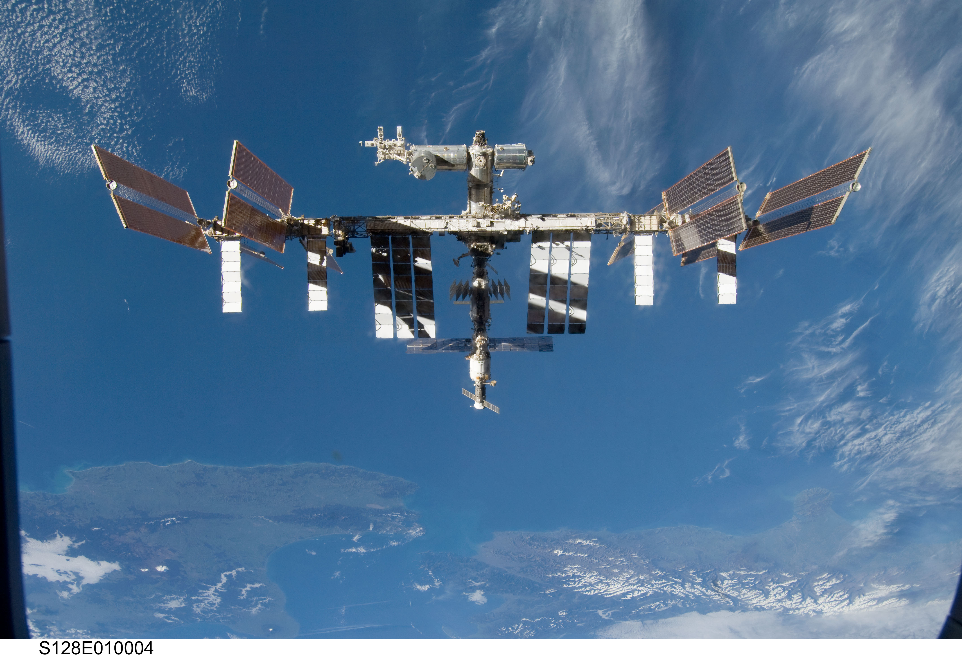
INTRODUCTION
Tracking the International Space Station (ISS) in real-time presents a fascinating intersection of astronomy, technology, and data visualization. This project aims to create a dynamic Python script that fetches the current location of the ISS, maps its coordinates onto a world map, and displays the names of the astronauts aboard. By leveraging public APIs and various Python libraries, this script provides an engaging and educational tool for users to observe the continuous movement of the ISS across the globe.The ISS orbits the Earth approximately every 90 minutes, traveling at a speed of around 28,000 kilometers per hour (17,500 miles per hour). Given its rapid movement, providing real-time updates is essential to accurately represent its position. This project uses the Open Notify API to retrieve the current latitude and longitude of the ISS every five seconds. Additionally, it fetches the names of the astronauts currently on the ISS, enhancing the educational value by giving users insights into the human aspect of space missions.

Slide 4
TECHNICAL DESCRIPTION
Software Requirements :
Python 3.6 or higher.
Python json , turtle , urllib, folium , webbrowser modules.
Operating System : Compatible with windows, Linux and macOS.
Any compatible IDE.
By ensuring the above software requirements, we can successfully implement the ISS Tracker using Python.

Slide 5
LIBRARIES
json: used for working with JSON (JavaScript Object Notation) data. JSON is a popular data interchange format that's easy for humans to read and write and easy for machines to parse and generate.
turtle: is used for creating graphics and drawings. It provides a virtual canvas where you can control a "turtle" that moves around the screen to draw shapes, patterns, and pictures.
webbrowser: module in Python provides a high-level interface to allow displaying Web-based documents to users. It is used to open URLs in a web browser.
folium: associated with educational software or tools, specifically designed for use in schools or educational institutions. It is a part of the Saisoft or Flexibuzz suite of products.

Slide 6
PROCEDURE
1.API Integration: Fetching ISS Data
Accessing the ISS API
Parsing JSON Data
Periodic Updates
The project utilizes the Requests library to fetch real-time data from the ISS API, which provides the current latitude and longitude coordinates of the station.
The JSON library is used to parse the response from the API, extracting the necessary information to update the map's marker with the ISS's precise location.
The time library is employed to implement a 5-second refresh interval, ensuring the map continuously reflects the latest position of the ISS as it orbits the Earth.

Slide 7
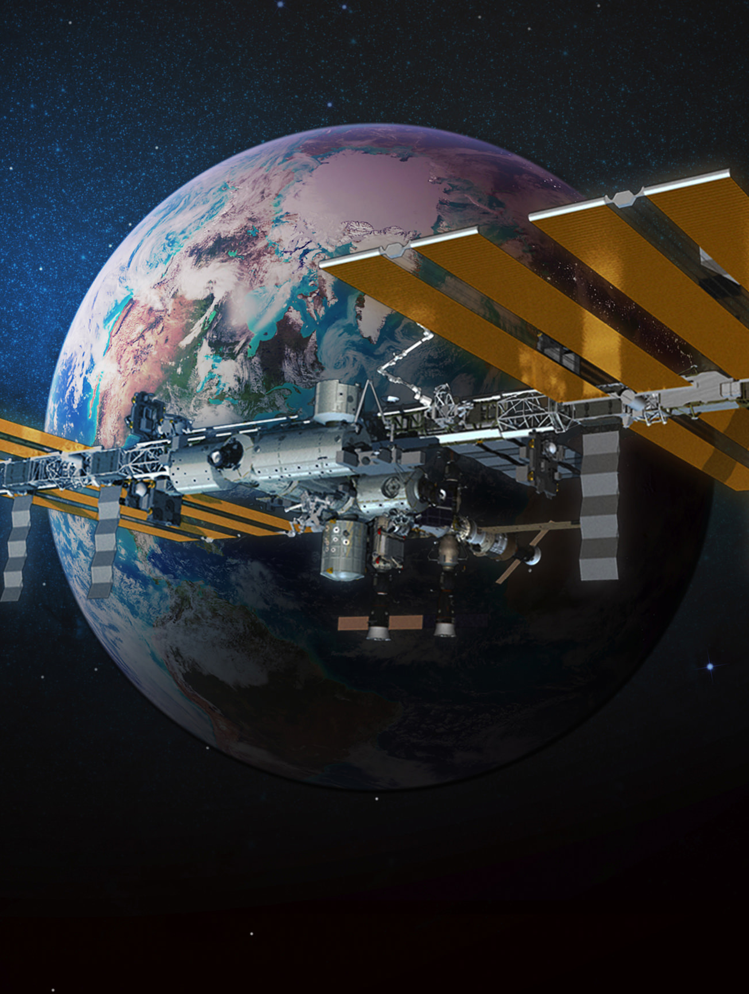
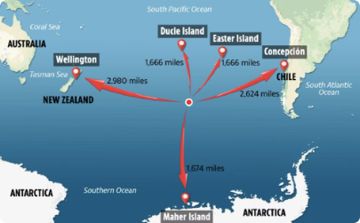
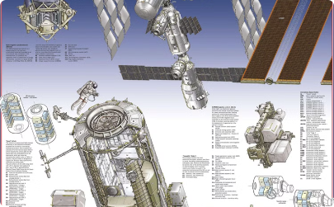
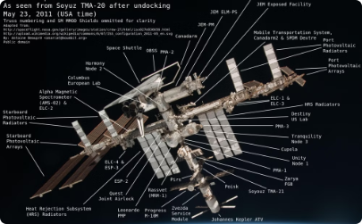
VISUALISING THE ISS LOCATION
Real-time Marker
Informative Cards
Satellite View
The ISS's current location is represented by a distinctive marker on the itneractive map, providing a clear visual reference for users.
Clicking on the marker reveals an informative card with details about the ISS, including its altitude, velocity, and other relevant information.
The map allows users to switch between different views, including satellite imagery, to further enhance the visualization of the ISS's position and movement.

Slide 8
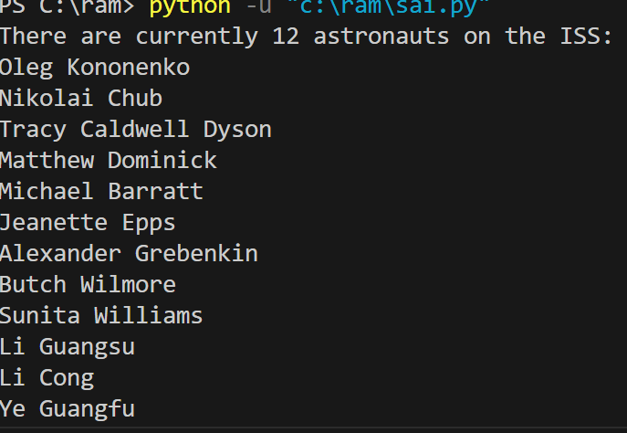
RESULTS

Slide 9
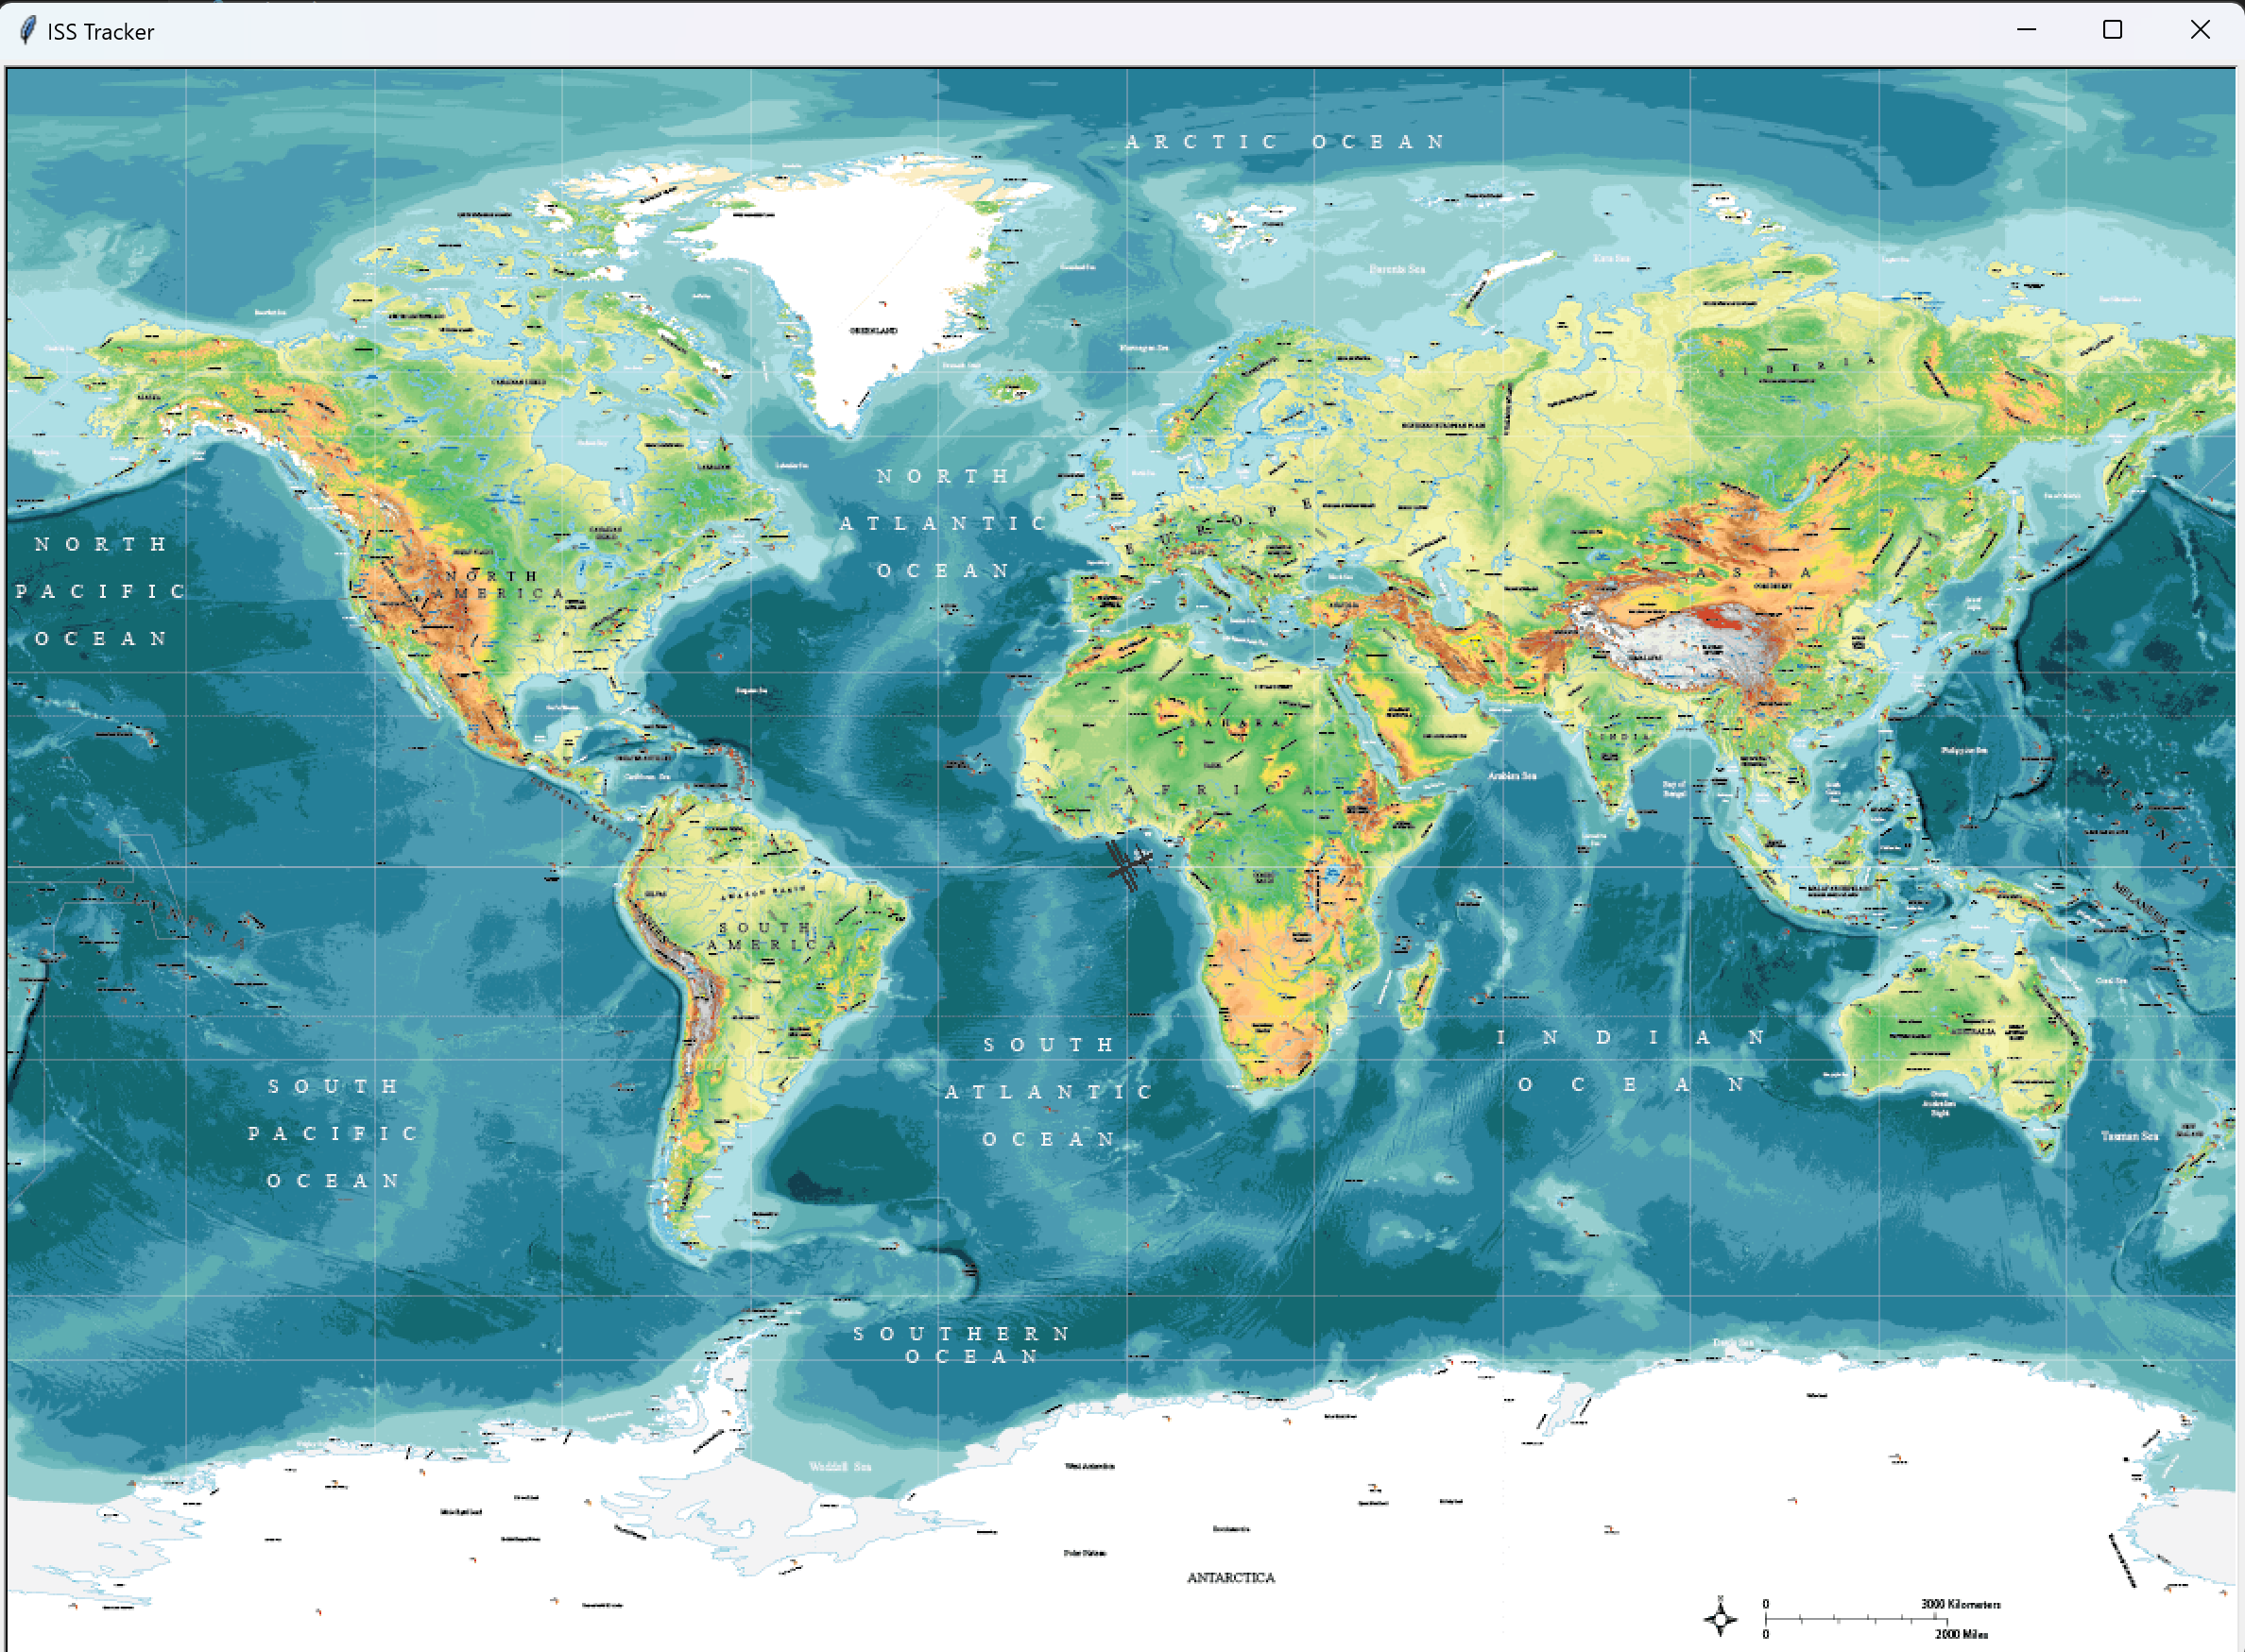

Slide 10
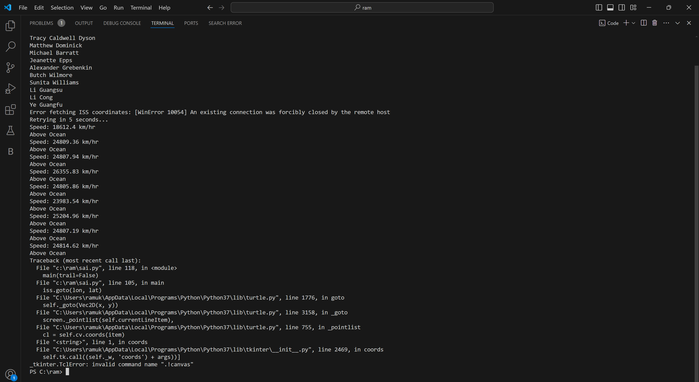

Slide 11

CONCLUSION
The dynamic Python script we’re building will allow users to track the ISS in real-time. By fetching its current location, mapping it on a world map, and displaying astronaut names, we create an engaging educational tool that captures the wonder of space exploration.

Slide 12
THANK YOU

Slide 13
ANY QUESTIONS ?

